Slide 1



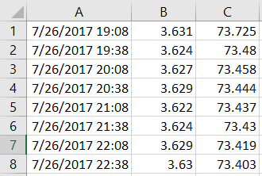
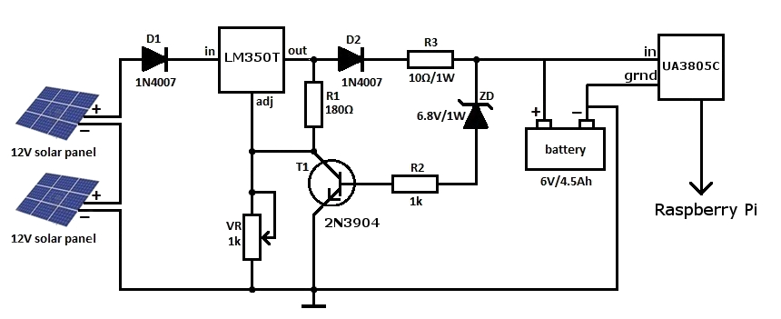

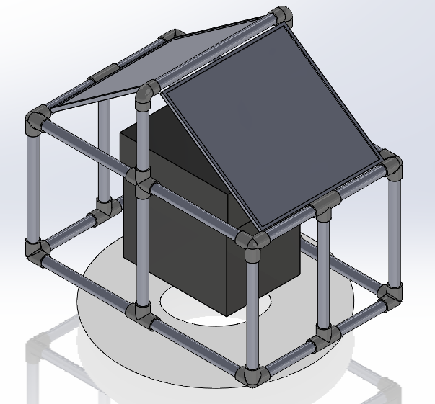
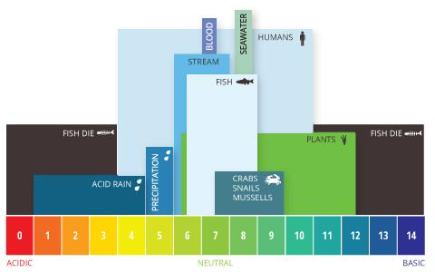
PH Integrated Sensor Housing
Alex Vargus, Kelsey Malone, Moira Murphy & Mary Walsh
Abstract
Importance of pH
Data From Test Run
Remote Operation
The purpose of this project was to design and develop a system capable of testing water for pH, temperature and have the possibility to add Dissolved Oxygen in the future. Taking the Wachusett Reservoir as an example, the water has a pH in a range of 6-7with minor fluctuations [1]. Depending on the depth measured, the temperature of the water can vary drastically, this will also be affected by the time of year.
The system collects data every hour and will display the most recent pH and Temprature results on the website’s homepage. In addition users can view and download past logs in the form of csv files. These files are easily integrated with Microsoft Excel for further analysis.
The pH (power of hydrogen) scale is a standard way to measure the how acidic or basic a liquid is based on a scale from 0-14 with 7 being neutral
.
Lower pH (0-6):
more acidic
corrosion
coral bleaching
Higher pH (8-14):
reduce amount of available oxygen
algal blooms can kill the water
Marine life:
thrives in a pH between 6.5-9
can adapt to outside range
In addition to marine life, monitoring the pH and temperature are necessary in reservoirs in order to meet water quality standards for drinking water.
The device is designed to sit on a body of water for an extended period of time. Inside the housing there is one 6 volt battery that is responsible for powering the Raspberry Pi and it’s sensors. The battery is recharged thought the day by two 12 volt solar panels, the panels are capable of generating power even during cloudy days. We used a series of voltage regulators to downgrade the 12 volt input to a 5 volt output for the Raspberry Pi
Figure 3: Data we collected during an overnight test run and then impotred to Excel
Scan this to visit our website and see live updates. Or go to:
http://10.40.10.62/index.html
(must be on eduroam wifi)
3-D Render:
How it works
Figure 4: A detailed diagram of the circuitry which keeps the voltage at useable levels
The Raspberry Pi is powered by a special distribution of Debian Linux known as “Raspbian”. It uses Apache 2.0 to host it’s own web site. The site can currently be reached by anyone on the same network as the device, but can easily be adapted to the world wide web. The sensors are attached to the Pi’s I2C ports and data is pulled off of them using Python. The Script we wrote takes samples every 10 minutes and then takes the average of the last 3 results to minimize outliers. The data is all stored in a .csv file for use in Microsoft Excel.
References
[1] Massachusetts Department of Conservation and Recreation. "Water Quality Report: 2016 Wachusett Reservoir Watershed." Mass.gov. Dcr Massachusetts, n.d. Web. 28 June 2017.
[2] Fondriest Environmental, Inc. “pH of Water.” Fundamentals of Environmental Measurements. 19 Nov. 2013. Web.
[3] Massachusetts Department of Conservation and Recreation, Division of Water Supply Protection Office of Watershed Management. Water Quality Report: 2016 Wachusett Reservoir Watershed.
Figure 1: 3-D render included two solar panels surrounding the battery box
Figure 2: A chart that shows diffrent pH levels and their effect on marine life

